Slide 1

Online Tools GSA SmartPay® Training Forum John Beall

Slide 2
What are we talking about today?
GSA SmartPay Website & Training Website
Online Training
Training Reports
Other Available Online Tools
Communication Tools
Celebrating 25 Years Supporting your mission
Looking ahead to 2024….

Slide 3
GSA SmartPay Website Tour
Includes Program Information, Tools, and Resources
Bridges the Gap Within the Global Community of A/OPCs, AOs, Account Holders and Others
Search GSA SmartPay
Mobile/Table Friendly

Slide 4
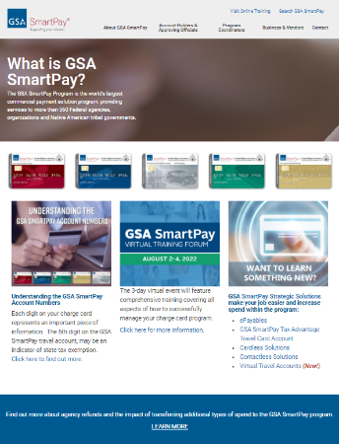
Navigating the GSA SmartPay Website
Top Navigation Categorized by Your Role in the Program
Card Images Highlight Different Business Lines
Smart Bulletins, News, & Events
Statistical Graphs
Shortcut Icons

Slide 5
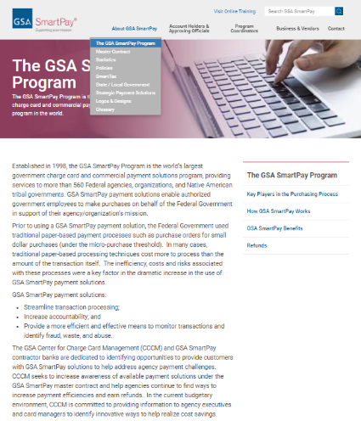
The GSA SmartPay Program
General Information about GSA SmartPay
Key Players in the Purchasing Process
How GSA SmartPay Works
SmartPay Benefits
Refunds

Slide 6
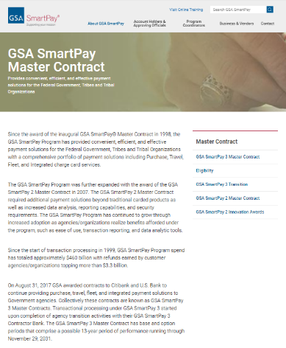
Master Contract
GSA SmartPay 3 Master Contract Terms and Conditions
Latest Contract Modification
Links to Attachments
Bank Information
Eligibility
GSA SmartPay Transition
GSA SmartPay 2 Master Contract Archive

Slide 7
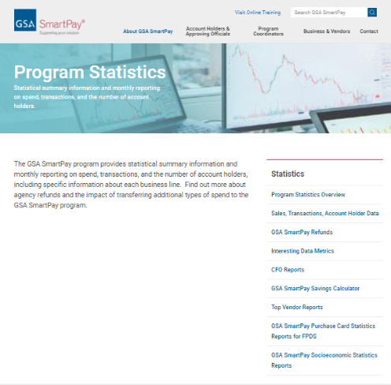
Statistics
Program Statistics Overview
Executive summary
Sales, Transactions and Account Holder data
GSA SmartPay Refunds
Interesting Data Metrics

Slide 8
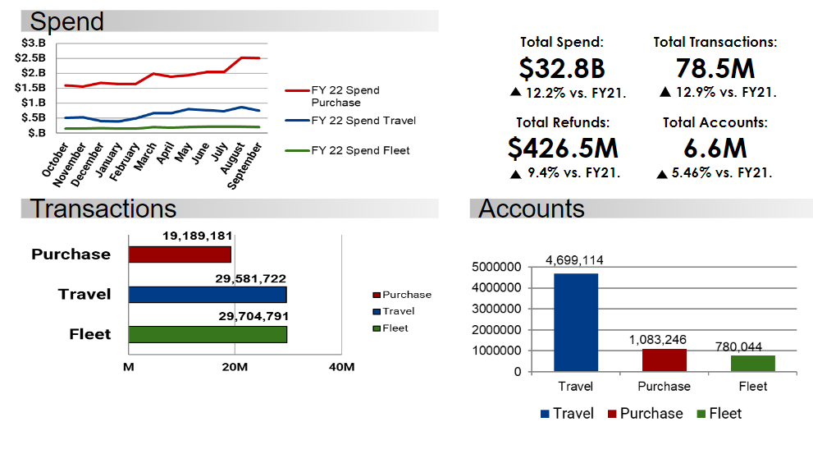
FY22 Program Statistics

Slide 9
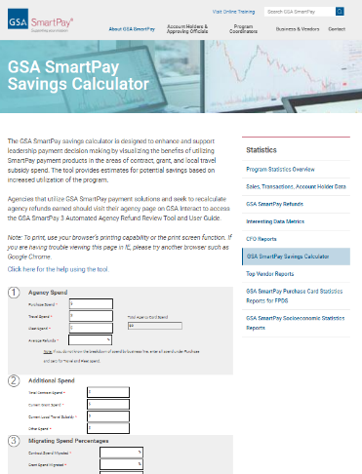
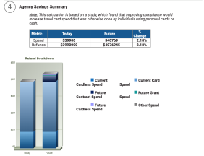
GSA SmartPay Savings Calculator
Interactive Tool Demonstrating the Impact of Transferring Spend to GSA SmartPay
Downloadable Version Available
Gives estimates for savings in the areas of:
Contract
Grants
Local Travel Subsidy
Help guide for instructions

Slide 10
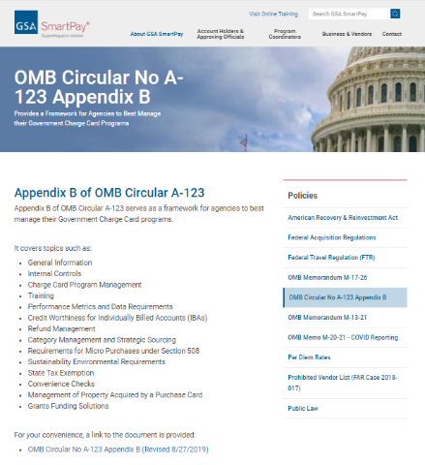
Policies
OMB Circular No A-123 Appendix B
OMB Memorandum M-13-21
OMB Memorandum M-17-26
OMB Memo M-20-21 (COVID-19)
Federal Travel Regulations (FTR)
Federal Acquisition Regulations (FAR)
Prohibited Vendor List (FAR Case 2018-017)
Per Diem Rates
Public Laws
American Recovery and Reinvestment Act

Slide 11
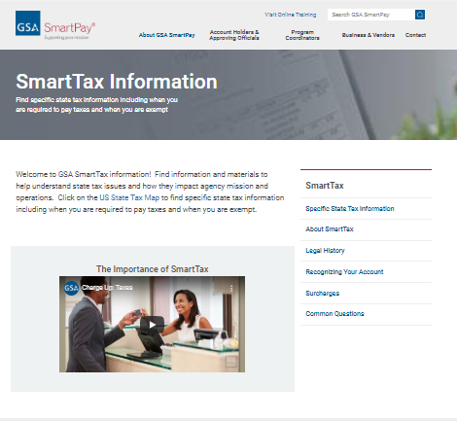
SmartTax
Legal History
Recognizing Your Account
Surcharges
Common Questions
Specific State Tax Information
Interactive map for state tax exemptions and requirements

Slide 12
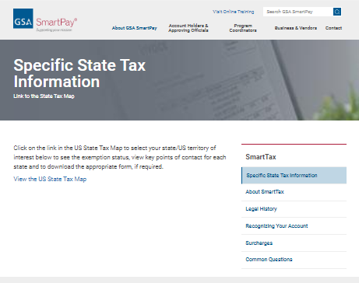
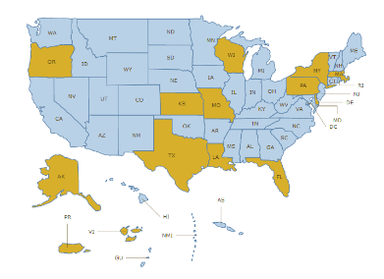
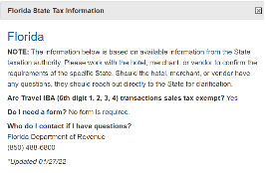
smartpay.gsa.gov/SmartTax
Each state determines its own tax exemption status and procedures
CBAs are exempt in every state
IBAs are exempt in some states
Forms and specific instruction
State tax POC information

Slide 13
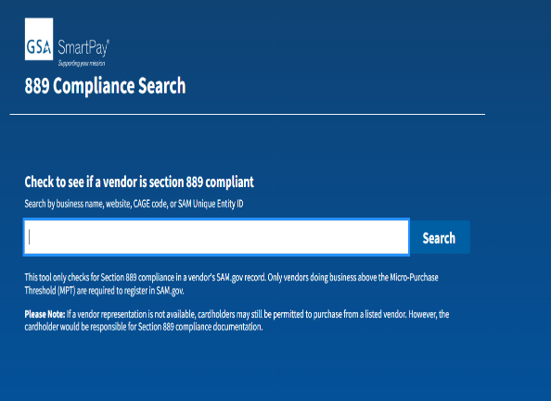
New 889 Tool
Protect yourself and your agency by checking the prohibited vendor list before making any telecommunications purchase.
The Federal Acquisition Regulation (FAR) case 2018-017 prohibits the purchase of covered telecommunications equipment and services from vendors who sell products containing spyware. These devices could pose a threat to US security by spying on or disrupting communications within the US.

Slide 14
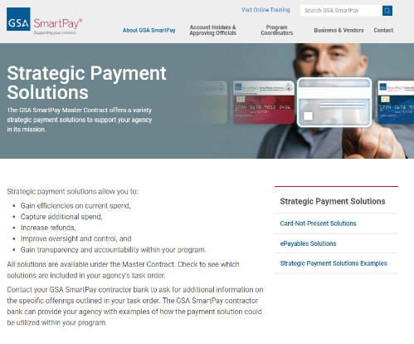
Strategic Payment Solutions
Information on Solutions Available Under the Master Contract.
Card Not Present Solutions
Declining Balance Cards
Ghost Cards
Mobile Payments
Single Use Accounts (SUA)

Slide 15
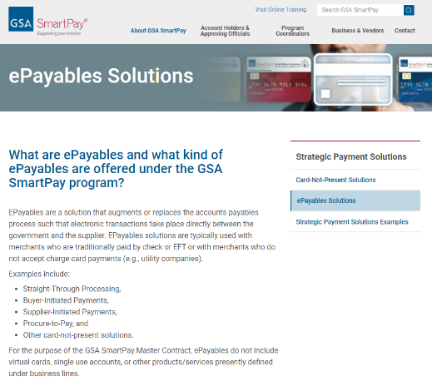
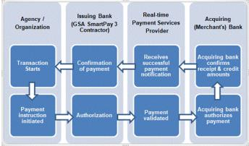
Strategic Payment Solutions
ePayables
Supplier Initiated Payments (SIP)
Buyer Initiated Payments (BIP)
Straight Through Processing (STP)

Slide 16
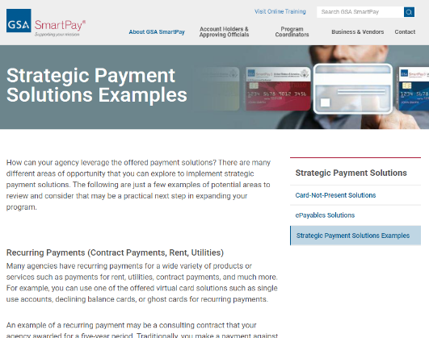
Strategic Payment Solutions
Strategic Payment Solution Examples
Recurring Payments
Contract Payments, Rent or Utilities
New Employees, Temporary Employees, or Part-time Employees
Supplier Retail Operations
Specialized or Complex Invoicing Processes

Slide 17
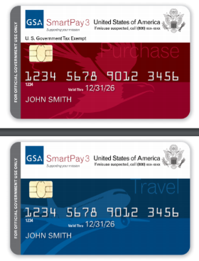
Logos & Designs
GSA SmartPay Logos and Card Designs are Available Online and Easily Downloadable for Your Agency to Use
Note: Designs may not be reverse engineered, sold, or modified without the express written consent of the GSA CCCM

Slide 18
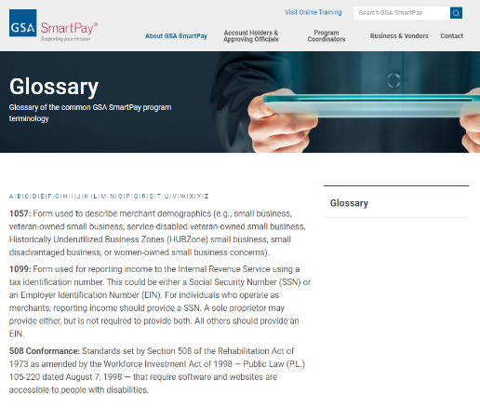
Glossary
Glossary of the common GSA SmartPay program terminology
Organized alphabetically

Slide 19
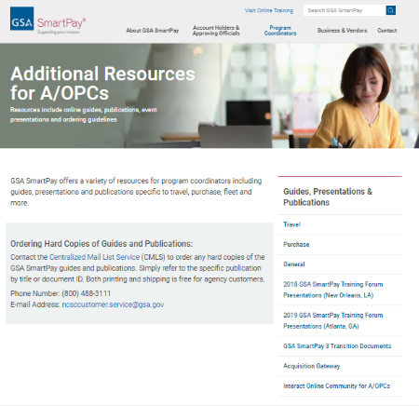
Guides, Presentations and Publications
Organized by Business Line
Brochures, Flipbooks, Presentations, Transition Documents
Links to the Acquisition Gateway and Interact

Slide 20
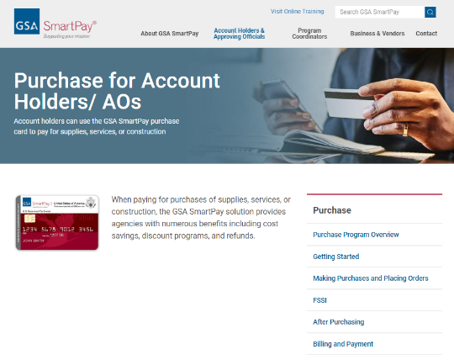
Account Holders & Approving Officials
Dedicated business line:
Purchase
Travel
Fleet
Integrated
Choose the desired business line for:
Program overview
Responsibilities
Topics specific to that program

Slide 21
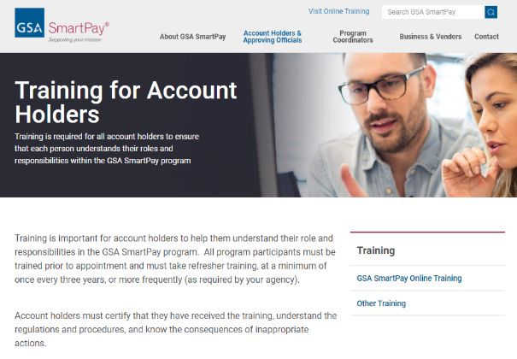
Account Holders & Approving Officials
Additional Information Includes:
Training
Guides, Presentations, and Publications
Fraud Prevention
Common Questions

Slide 22
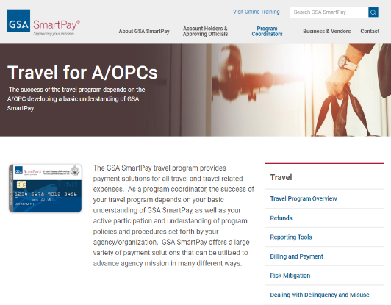
Program Coordinators
Dedicated Business Line Sections:
Purchase
Travel
Fleet
Integrated
Choose the Desired Business Line
Program overview
Best practices
Reporting lost or stolen cards
Reporting tools

Slide 23
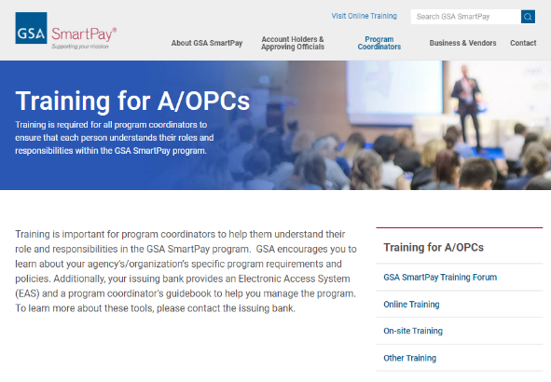
Program Coordinators
Additional information includes:
Training for A/OPCS
Guides, presentations, and publications
Audit repository
Fraud prevention
Common questions

Slide 24
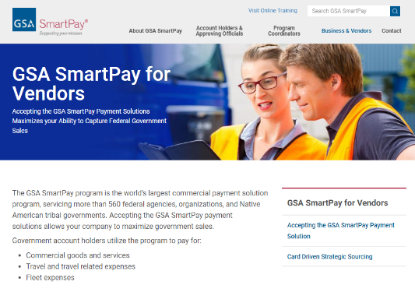
Business & Vendor
Overview of GSA SmartPay program with a business/vendor focus
Recognizing the GSA SmartPay Payment Solution
Vendor Resources
Common Questions

Slide 25
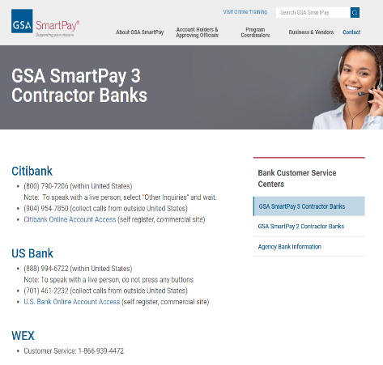
Contact
Bank Customer Service Centers
GSA SmartPay Contractor Banks
Phone Numbers
Online Account Access
Agency Bank Information
GSA SmartPay Program Support
General Information
GSA SmartPay Points of Contact

Slide 26
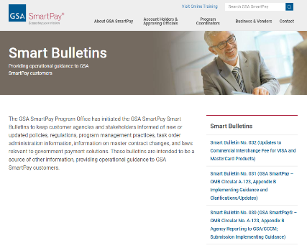
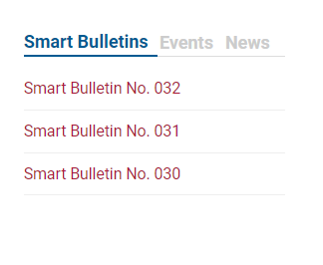
Smart Bulletins
Provides Information and Guidance to Customer Agencies
New or updated policies
Regulations
Program management best practices
Task order administration
Master Contract changes
Related laws

Slide 27
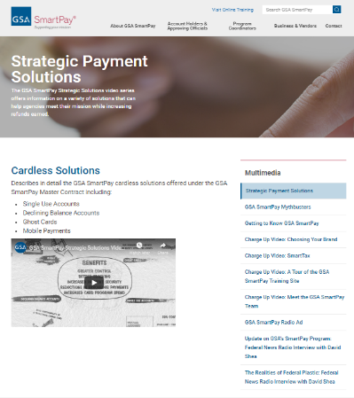
Multimedia
Multimedia and Videos
Strategic Payment Solutions
Mythbusters Series
Getting to Know GSA SmartPay
Charge Up Video Series
Radio Interviews with David Shea

Slide 28
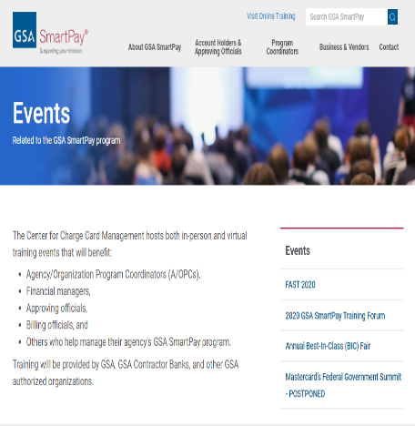
Events
In-person and virtual training events for:
Agency/Organization Program Coordinators (A/OPCs)
Financial managers
Approving officials
Billing officials
Others managers of the GSA SmartPay program
Provided by GSA, GSA contractor banks, and other GSA authorized organizations

Slide 29
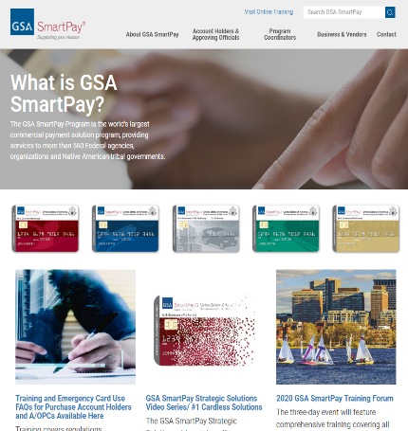
Looking for something? Use the Search!
Search provides accurate results
Result links take you directly to the page with the information you are searching for

Slide 30
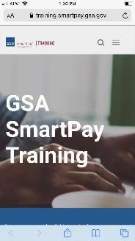
Mobile Friendly
Easily Browse All Content from a Mobile Device
Access State Tax Information, Online Training, and Videos!

Slide 31
OMB Training Requirement
Appendix B of OMB Circular A-123 requires each agency to provide training to all account holders and account managers prior to appointment and every 3 years (or more often if required by your agency’s training policy)

Slide 32

What Does GSA Provide?
GSA offers these FREE Government-wide online on-demand training courses:
Travel Account Holder/ AO
Travel A/OPC
Purchase Account Holder/ AO
Purchase A/OPC
Fleet A/OPC
24/7 access to online course completion certificates
Training reports for Level 1 A/OPCs

Slide 33
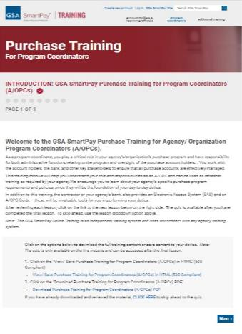
Training Courses Cover…
Program Overview
Key Program Participants
Program Coordinator/ Account Holder Responsibilities
Topics Specific to Business Line
Where to go for Questions
Policies/ Regulations
Risk Mitigation
Resources

Slide 34
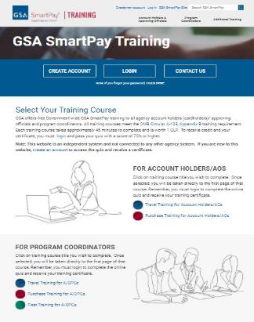
Navigating the GSA SmartPay Training
Access Online Training by selecting a course under either Account Holder or Program Coordinator
All training content can be accessed without logging in
Users MUST login or register to complete their quiz and receive a certificate
Each certificate comes with 1 CLP!

Slide 35
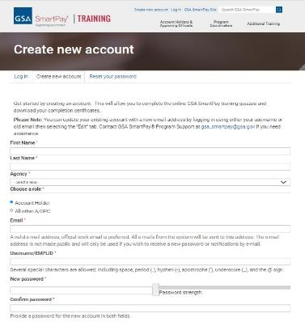
Create New Account
Easy one page, one time registration to create an account
Double check that your email and agency are correct
Select your role (A/OPC or Account Holder)
Create your own unique user ID
Set up a password and security question

Slide 36
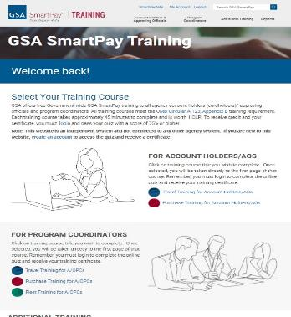
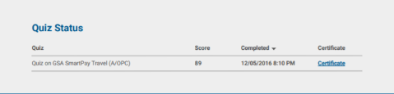
Logged In Homepage
Welcome Message at the Top
Listing of Courses Offered
List of all quizzes and links to certificates

Slide 37

Review the Course Material
Advance the training by using the “next” link on the bottom right
The table of contents allows you to navigate to specific lessons
Option to download training as a PDF to view offline or save as a reference

Slide 38
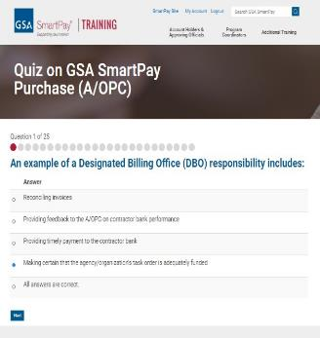
Completing the Quiz
A short quiz is presented at the end of each course
Each quiz has approximately 25 questions
A minimum score of 75% is required to pass the quiz and receive a certificate of completion
Click on “Start Quiz” to begin

Slide 39
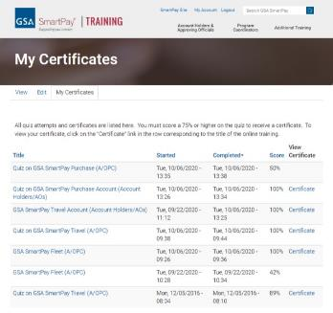
View Quiz Results and Certificate
Results display after you complete the final question in the quiz
Ability to review the questions you got wrong
If you passed, you will receive a certificate
If you did not pass, you can try again as many times as needed to pass

Slide 40
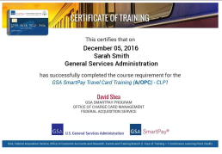
View Quiz Results and Certificate
Click on “My Certificates” tab in your account to view a list of completed courses
Click on “View Certificate” to view/ save/ print your training certificate for each course
“Ctrl + p” should allow you to print or save as pdf
All training certificates are saved at this location.

Slide 41
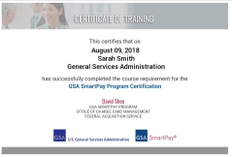
GSA SmartPay Program Certificate (GSPC)
Requirements include:
Complete Coursework, Hands on Experience, Maintenance Training Every 3 Years
Details in Smart Bulletin No. 22
Candidates will receive an email after the forum with instructions to:
Complete the questionnaire
Certificates will be available under your account

Slide 42
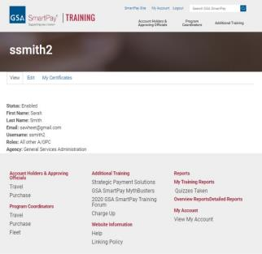
My Account
The following actions can be done under My Account
View your information
Edit your information
My Certificates – view, save, or print your certificate(s)
My Results – view your quiz scores
Note: Level 1 A/OPC users are not able to edit their agency name for security reasons.

Slide 43
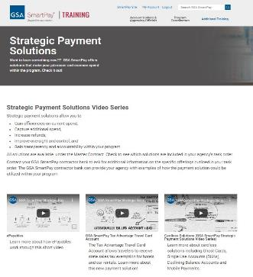
Additional Training
GSA SmartPay Videos on Specific Topics, examples Include:
The Accounts Payable File Review
Charge Up Video: SmartTax
GSA SmartPay Strategic Payment Solutions series
GSA SmartPay Mythbusters series

Slide 44
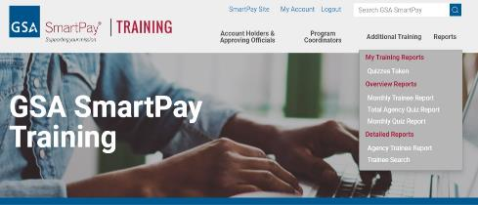
Reporting Overview
A variety of reports for Level 1 A/OPC and their delegates:
General Reporting (numbers only)
Monthly Trainee Report
Total Agency Quiz Report
Monthly Quiz Report
Detailed Reporting
Agency Trainee Report
Trainee Search
Your Personal Training Reports

Slide 45
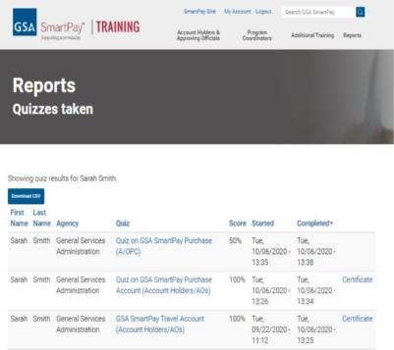
Reporting
Quizzes Taken by User
Quiz results for you, the A/OPC who is logged in
Similar to what you see under My Account/ My Certificates
Available for All Users

Slide 46
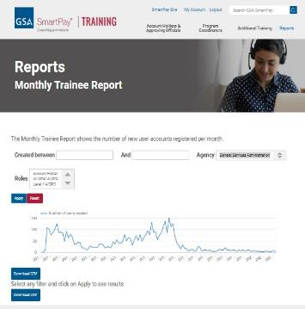
General Reporting
Monthly Trainee Report
The number of new user accounts registered per month
Overview only, no detail information
Filter on roles and date
Export to CSV (Microsoft Excel compatible)

Slide 47
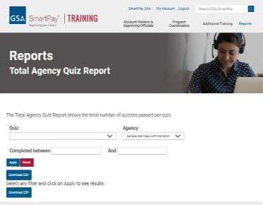
General Reporting
Total Agency Quiz Report
Total number of quizzes passed per quiz
Filter by course quiz and date
Overview only, no detail information
Export to CSV (Microsoft Excel compatible)

Slide 48
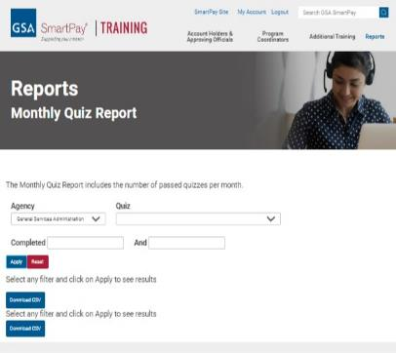
General Reporting
Monthly Quiz Report
Number of passed quizzes per month
Overview only, no detail information
Filter on courses and dates
Export to CSV (Microsoft Excel compatible)

Slide 49
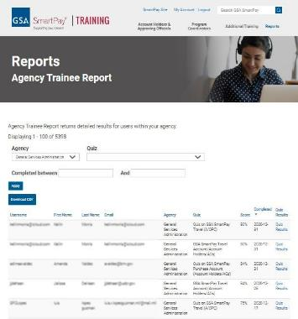
Detail Reporting
Agency Trainee Report
The passed quiz results for your agency, and / or a particular quiz.
Contains detailed information such as Username, First Name Last Name, Email, Agency, Quiz, Score, Completed.
Export to a file and can open and manipulate in Excel
Filter by quiz and date

Slide 50
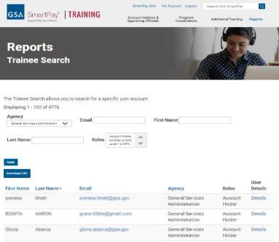
Detail Reporting
Trainee Search
Search for a specific account
Contains detailed information such as Username, First Name Last Name, Email, Agency Quiz, Score, Completed Dates and results
Export to a file and can open and manipulate in Excel
Filter by first name, last name, email and/or date

Slide 51
GSA SmartPay Training Mobile
Did you know you can complete your training on our mobile site?
You can do it all
Read the course
Take the quiz
View your certificate
Watch videos under Additional Resource
More fun than waiting for the late train!

Slide 52

Refunds Review Tool
Automatically calculates refunds as outlined in the SP3 Contract.
AOPCs can download the tool and user guide by visiting their "CFO Act Agency Reports and Dashboards" group on GSA Interact
Note: The tool does not replace the requirement for agencies to perform their own independent review and assessment as indicated in Public Law 112-194.

Slide 53

Interact Groups
Discussions with GSA SmartPay – Interact with other program coordinators or the GSA SmartPay team, share best practices, view non public documents, information, and events
CFO Act Agency Reports and Dashboards – Fiscal Year Metrics Dashboards, CFO reports, and Refund Summary Reports (Agency Specific)

Slide 54

Data Warehouse
A web application that houses numerous dashboards and report.
Available to customer agencies (primarily the 24 CFO Act Agencies)
Target users are A/OPCs who track agency spend
Located at https://spdatawarehouse.fas.gsa.gov/spdw/ (Login required)
For more information contact:
Shane Brosius (shane.brosius@gsa.gov)
Perry Hampton (perry.hampton@gsa.gov)

Slide 55
Mobile Application and Payments Options
Offered as Tier 1 products and services under the SmartPay 3 Master Contract at no additional cost:
Mobile Applications
The ability to access EAS, pay invoices, receive text/email alerts, and view statement and payment information over a mobile device.
Mobile Payments
The ability to make payments via mobile device at the point-of-sale.

Slide 56

Communication
Where do I go for GSA SmartPay Updates and Announcements?
Social Media:
Twitter
Facebook
LinkedIn
GSA SmartPay website
Participate in GSA SmartPay meetings and focus groups
Read all email communication from GSA SmartPay and pass it along to your account holders

Slide 57

Communication, Cont.
Connect with other A/OPCs to share best practices
GSA SmartPay Forum
GSA Interact
How can I contact the GSA SmartPay team?
For general information about the program or for escalated issues, please contact a member of the GSA SmartPay program support team:
Email: gsa_smartpay@gsa.gov
Phone: (703) 605-2808

Slide 58

25 Years
GSA SmartPay is celebrating being 25 years old.
Been a fun ride from SmartPay 1 to SmartPay 3.

Slide 59
Looking Ahead to 2024….
New A/OPC Monthly Training
Login less approach for online training.
New website

Slide 60
Questions?
I need help!
John Beall
John.beall@gsa.gov

Slide 61

GSA Starmark Logo

